Slide 1
CREDIT CARD FRAUD DETECTION USING CNN
Presented by:
Hariharan s.b
III year ,AI & DS
COLLEGE-KVCET
NM ID-au421221243039
Email ID- ravibala9842@gmail.com

Slide 2
PROPOSED SYSTEM
Tis project mainly Utilizing Convolutional Neural Networks (CNN) for enhanced credit card fraud detection. Credit card fraud remains a significant issue, causing substantial financial losses. Traditional methods often struggle to adapt to evolving fraud patterns. The proposed CNN-based system offers a promising approach to enhance credit card fraud detection. By leveraging deep learning techniques, it aims to improve accuracy and adaptability in combating fraud.

Slide 3
PROBLEM STATEMENT
Credit card fraud poses a significant threat to financial institutions and cardholders, resulting in substantial financial losses and compromised security. Traditional fraud detection methods often struggle to keep pace with evolving fraud tactics and fail to effectively distinguish between legitimate and fraudulent transactions. Developing a robust credit card fraud detection system using Convolutional Neural Networks (CNN) to address the limitations of traditional approaches, enhance detection accuracy, and enable real-time processing for effective fraud prevention

Slide 4
PROPOSED SOLUTION
Introducing a CNN-based approach for credit card fraud detection to address the limitations of existing methods and improve detection accuracy.
Why It's Needed:
Rising Fraud Instances: With the proliferation of digital transactions, credit card fraud incidents are increasing, necessitating more effective detection methods.
Evolving Fraud Tactics: Fraudsters continually adapt their techniques, making it crucial for detection systems to evolve accordingly.
Financial Impact: Fraudulent activities result in significant financial losses for both financial institutions and cardholders, highlighting the urgency for robust detection mechanisms.

Slide 5
SYSTEM APPROACH
Hardware
Processor: Intel Core i5 or equivalent (recommended)
RAM: 8 GB or more (recommended)
Storage: Sufficient space to store your data and software
Software
Python (programming language)
TensorFlow (machine learning library)
Keras (deep learning library)
NumPy (numerical computing library)
Pandas (data analysis library)
Matplotlib (plotting library)

Slide 6
ALGORITHM AND DEPLOYMENT
Algorithm:
Implement a CNN architecture consisting of convolutional layers for feature extraction, pooling layers for feature aggregation, fully connected layers for learning complex patterns, and an output layer for classification of transactions as legitimate or fraudulent.
Deployment:
Model Training: Train the CNN algorithm on labeled credit card transaction data to learn patterns of fraudulent behavior.Problem Formulation:
Model Testing and Evaluation: Evaluate the trained CNN model using metrics such as accuracy, precision, recall, and F1-score to assess its performance.
Real-time Deployment: Deploy the trained CNN model into production systems for real-time credit card fraud detection, integrating it seamlessly with existing transaction processing pipelines.

Slide 7
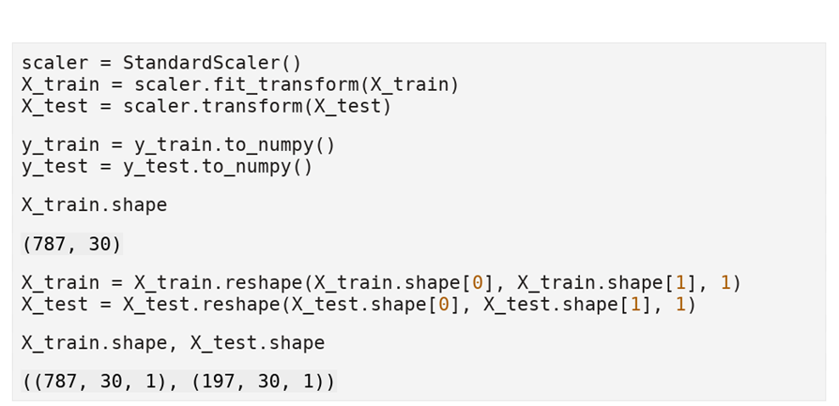
TRAINING AND PROCESS
Data splitting using train_test_split
Feature scaling using the MinMaxscaler
Model training using Convolutional Neural Network (CNN) which Utilize convolutional layers to extract spatial patterns from input data.
Incorporate pooling layers to reduce spatial dimensions and retain essential information.
Add fully connected layers for classification/regression.

Slide 8
PREDICTION PROCESS
New data input from Raw transaction data, including transaction amount, location, time, etc.
Preprocessing data using scaling ,encoding, normalization.
Performing the Model Inference on pre processed data
Interpret results to Extract features such as transaction patterns, frequency, and anomalies
Classify transactions as fraudulent or legitimate.

Slide 9
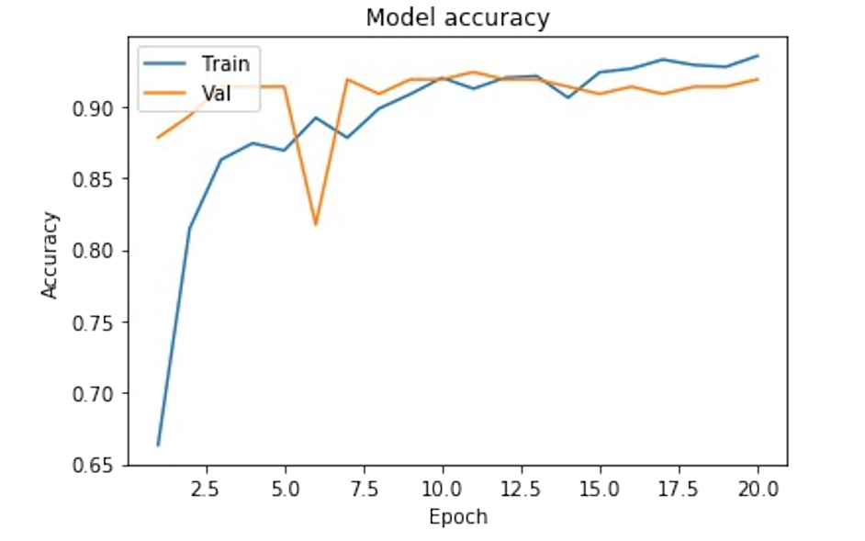
RESULT

Slide 10
CONCLUSION
In conclusion, the utilization of Convolutional Neural Networks (CNN) for credit card fraud detection represents a pivotal advancement in financial security. With their ability to discern intricate patterns, CNNs offer heightened accuracy in identifying fraudulent transactions compared to traditional methods
By continuously updating and adapting to evolving fraud tactics, CNN-based systems stand as a future-ready solution for long-term security in the financial sector.

Slide 11
REFERENCES
Shivangi Aggarwal, Ritu Bhargava, "Deep Learning Approach for Credit Card Fraud Detection," 2020 4th International Conference on Inventive Systems and Control (ICISC), 2020.
Wenjie Ruan, Xu He, and Zhihao Hao, "Real-time Credit Card Fraud Detection Using Deep Learning: A TensorFlow-based CNN Model," 2019 IEEE International Conference on Big Data (Big Data), 2019.
Tingxi Wen, Xiangyu Wang, Thomas Maillart, "A Comparative Study of Credit Card Fraud Detection Using Neural Networks and Support Vector Machines," 2019 IEEE International Conference on Big Data (Big Data), 2019.

